Slide 1



On Combining Diverse Models for Lyrics-Based Music Genre Classification
Caio L. R. S. Ueno Diego Furtado Silva
Laboratório de Mineração de Dados e Aplicações (MIDAS)
Departamento de Computação
Universidade Federal de São Carlos

Slide 2
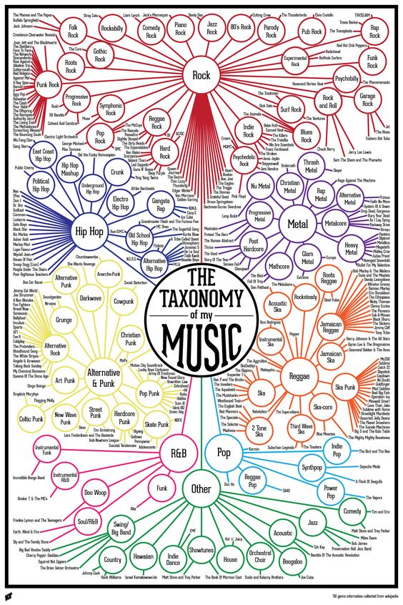
Introduction
Introduction
Automatic music organization and retrieval is a highly required task nowadays, especially for music and video streaming platforms, such as Spotify and YouTube.
However, classifying music by genre is a hard task even for human beings.

Slide 3

Experimental Setup
Only the lyrics were used as input for the genre classification models implemented. Some models are based on traditional NLP techniques, essentially bag-of-words, but also on neural networks and word-embedding.

Slide 4
Related work
Tsaptinos published a paper in which he uses a deep neural network lyric-based. Specifically, the author uses a hierarchical attention network (HAN), which considers the text structure, term/sentence/document.
Other papers present different goals, commonly associated with emotion/sentiment analysis. Besides, they also use the respective audio as one of the inputs for their models.

Slide 5
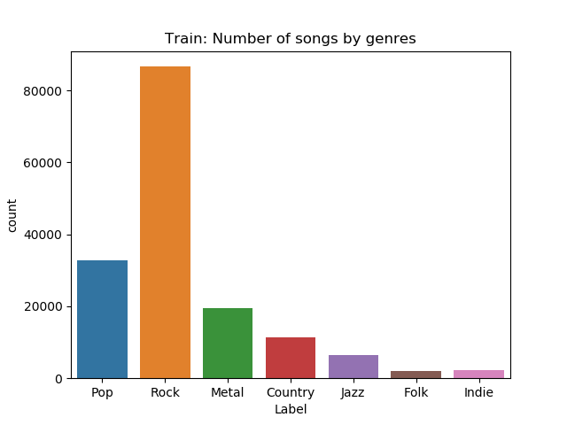
Datasets
All models were trained and tested with 5 datasets. Only one of them, the smallest, is genre balanced, and it is also a subset of the biggest dataset.

Slide 6
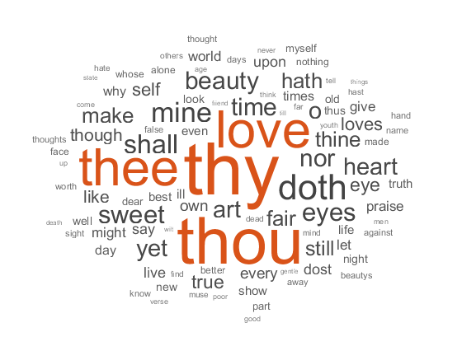
Traditional approach (bag-of-words)
Naive Bayes
Support Vector Machines
Linear Regression
XGBoosting
Random Forest

Slide 7
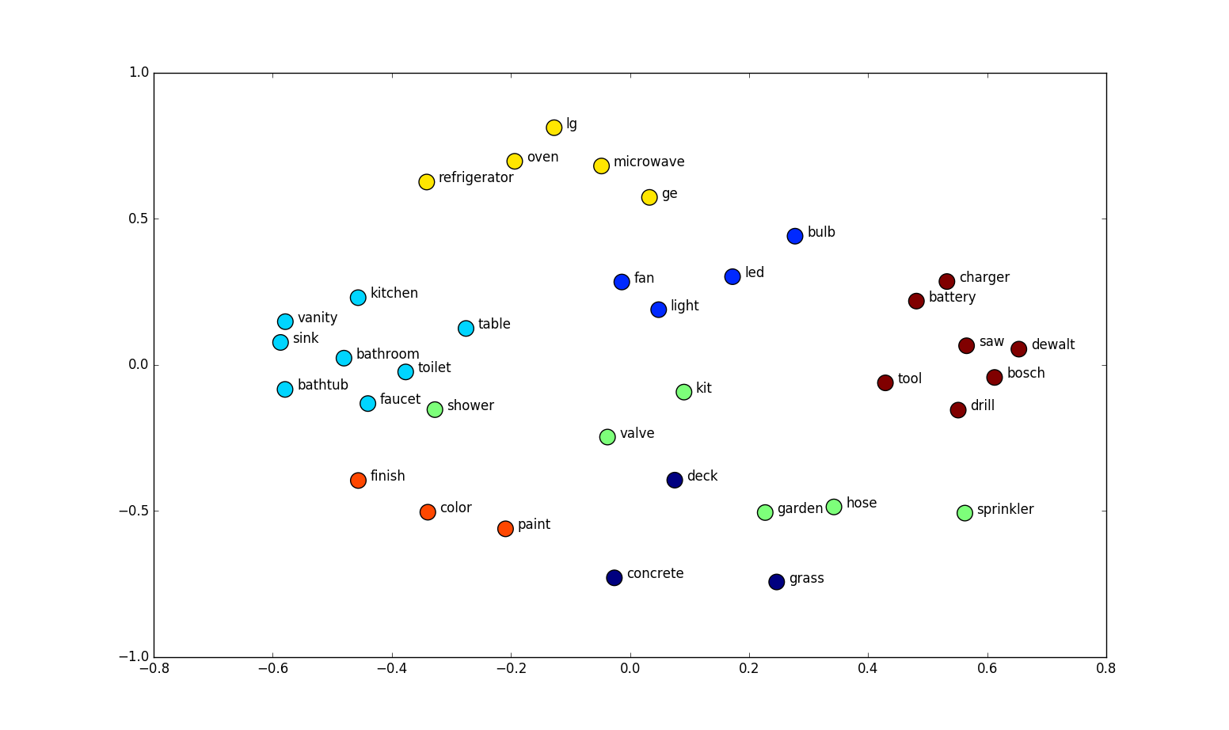
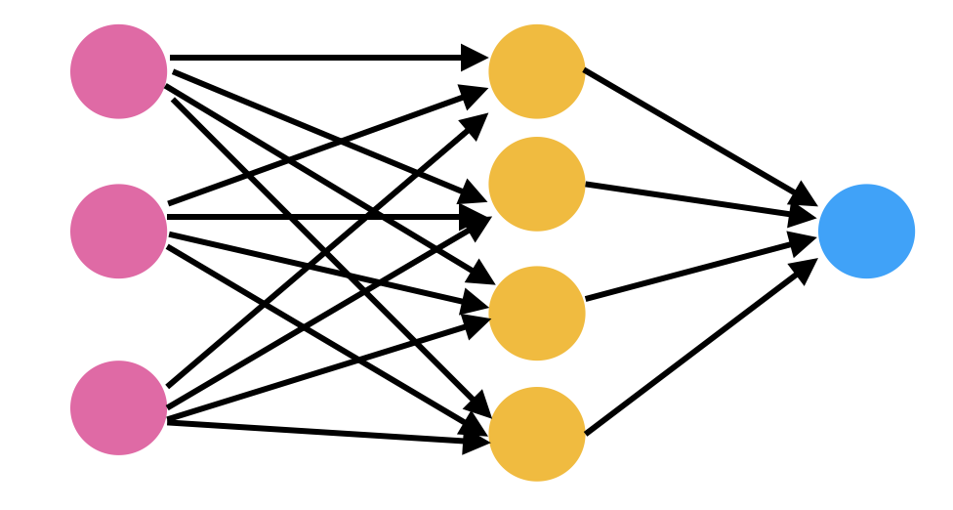
Neural networks and word-embedding

Slide 8
Architectures
Neural network CNN + LSTM.
Neural network LSTM + CNN.

Slide 9
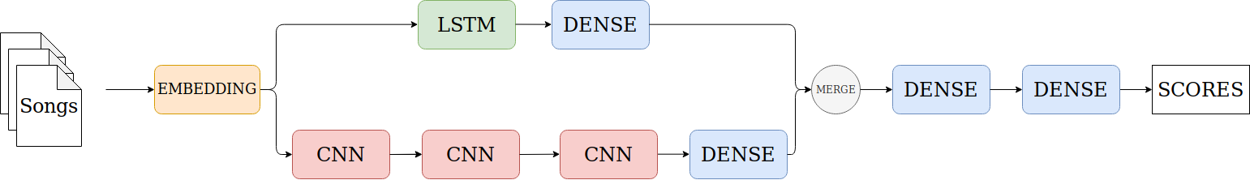
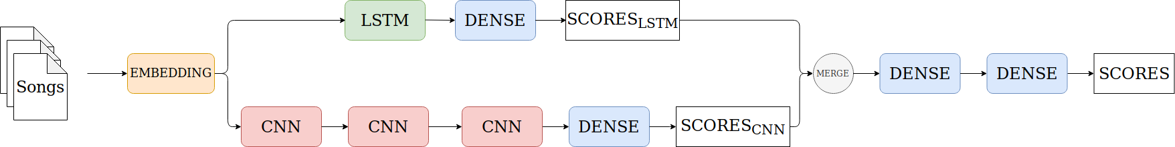
Merge
Merge architecture, first variation.
Merge architecture, second variation.

Slide 10
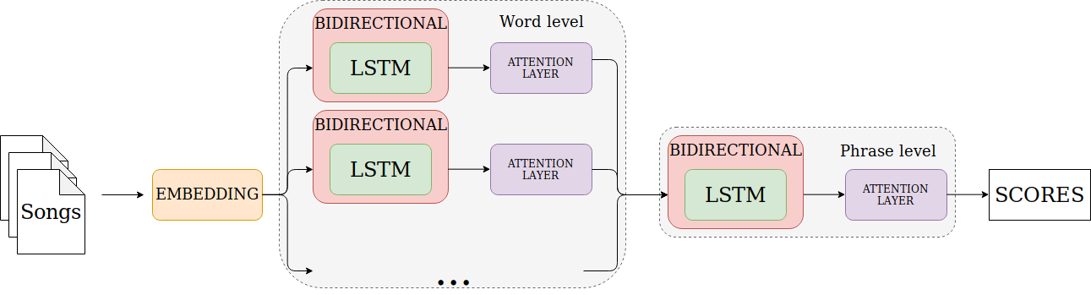
Hierarchical Attention Network
HAN architecture.

Slide 11
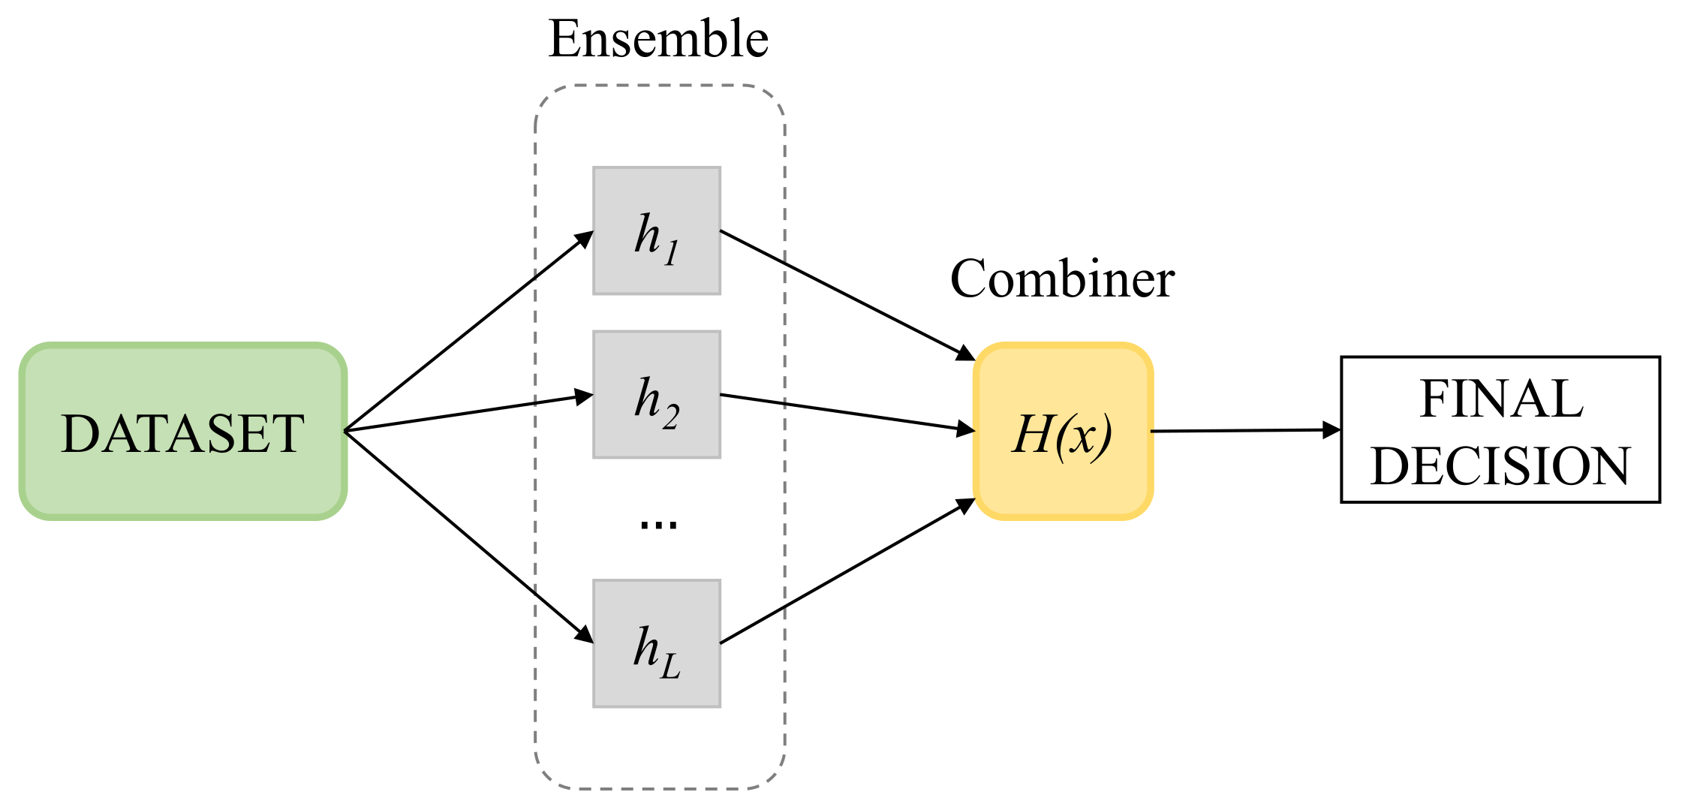
Ensembles
Combiner options:
Major voting
Weighted voting per classifier
Score averaging per instance
Meta-learning

Slide 12
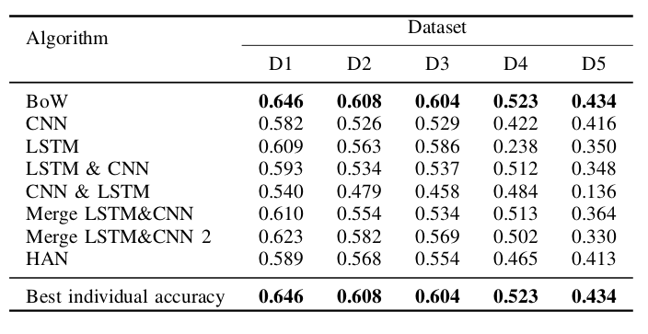
Individual Results

Slide 13
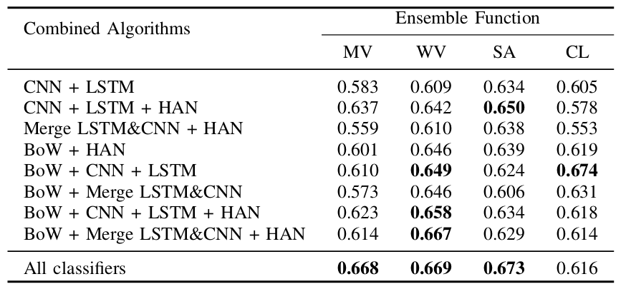
Ensemble results
It shows that combinations which use both bag-of-words and neural networks based on word-embedding approaches improve the accuracy.
D1 has best individual accuracy equals to 0.646.

Slide 14
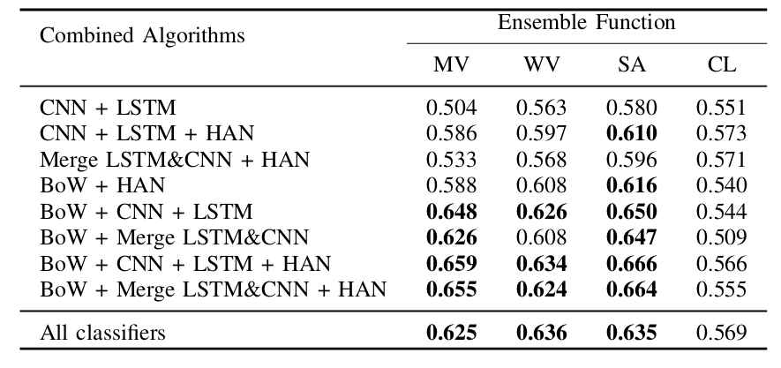
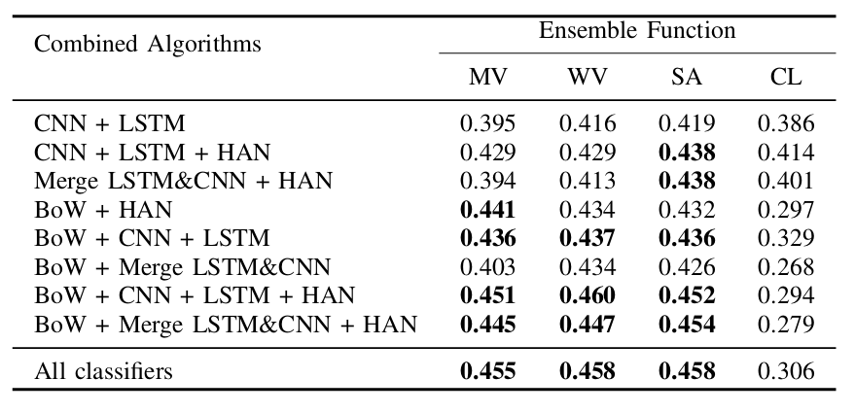
Ensemble results
D2 has best individual accuracy equals to 0.608.
Balanced dataset has best individual accuracy equals to 0.434.

Slide 15
References
Y. Murthy and S. G. Koolagudi, “Content-based music information retrieval (cb-mir) and its applications toward the music industry: A review,” ACM Computing Surveys (CSUR) , vol. 51, no. 3, p. 45, 2018.
A. Tsaptsinos, “Lyrics-based music genre classification using a hierarchical attention network,” in International Society for Music Information Retrieval Conference , 2017, pp. 694–701.
H. Xue, L. Xue, and F. Su, “Multimodal music mood classification by fusion of audio and lyrics,” in International Conference on Multimedia Modeling . Springer, 2015, pp. 26–37.
M. Huang, W. Rong, T. Arjannikov, N. Jiang, and Z. Xiong, “Bi- modal deep boltzmann machine based musical emotion classification,” in International Conference on Artificial Neural Networks. Springer, 2016, pp. 199–207.

Slide 16
Thank you!
My e-mail: caioluiggy@hotmail.com
Advisor’s e-mail: diego.fsilva@gmail.com
Departamento de Computação
Universidade Federal de São Carlos

